Slide 1

Chapter 4, Part I
Sorting Algorithms

Slide 2
Chapter Outline
Insertion sort
Bubble sort
Shellsort
Radix sort
Heapsort
Merge sort
Quicksort
External polyphase merge sort

Slide 3
Prerequisites
Before beginning this chapter, you should be able to:
  Read and create iterative and algorithms
  Use summations and probabilities presented in Chapter 1
  Solve recurrence relations
  Describe growth rates and order

Slide 4
Goals
At the end of this chapter you should be able to:
  Explain insertion sort and its analysis
  Explain bubble sort and its analysis
  Explain shellsort and its analysis
  Explain radix sort and its analysis

Slide 5
Goals (continued)
  Trace the heapsort and FixHeap algorithms
  Explain the analysis of heapsort
  Explain quicksort and its analysis
  Explain external polyphase merge sort and its analysis

Slide 6
Insertion Sort
Adding a new element to a sorted list will keep the list sorted if the element is inserted in the correct place
A single element list is sorted
Inserting a second element in the proper place keeps the list sorted
This is repeated until all the elements have been inserted into the sorted part of the list

Slide 7
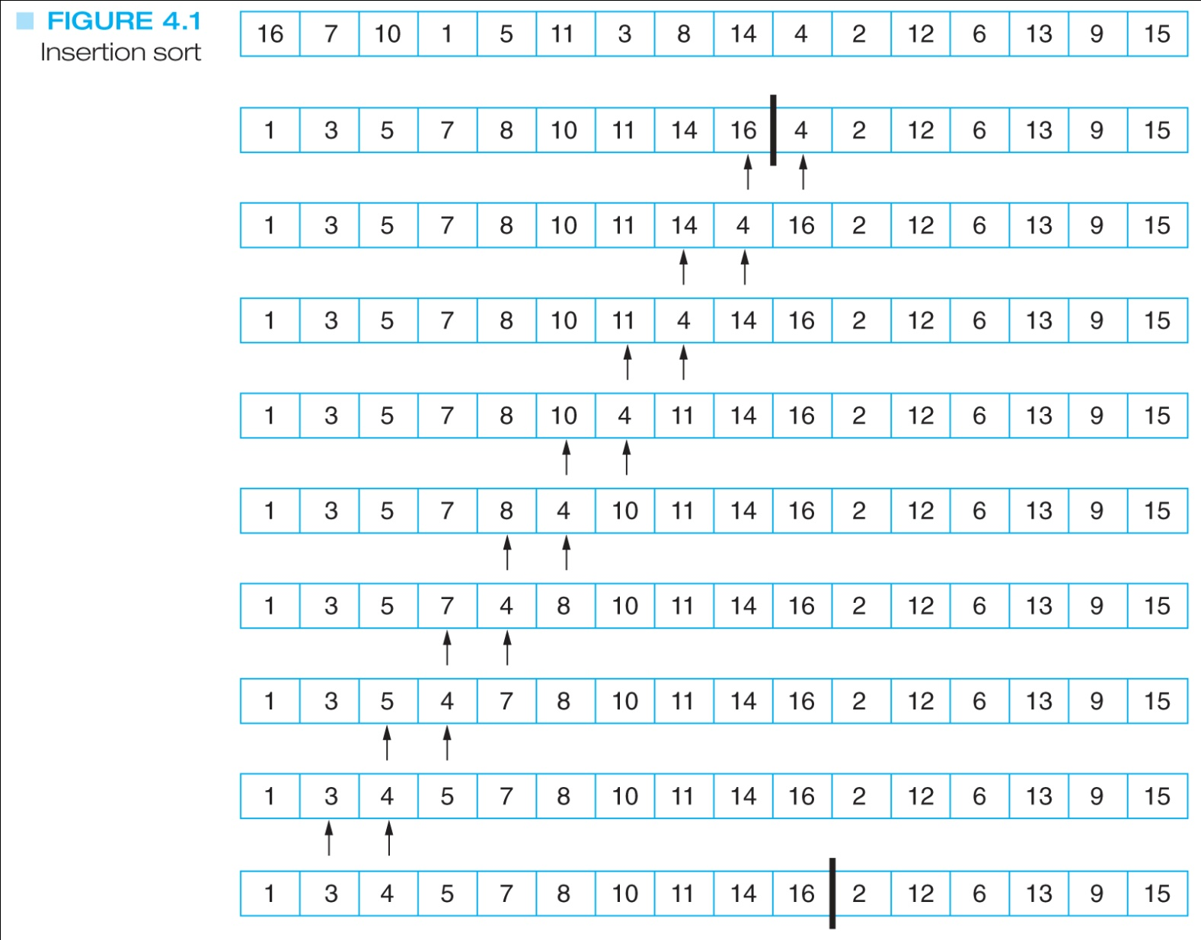
Insertion Sort Example
Sorted already
Not yet processed

Slide 8
Insertion Sort Algorithm
for i = 2 to N do
  newElement = list[ i ]
  location = i - 1
  while (location ≥ 1) and (list[location] > newElement) do
    list[location + 1] = list[location]
    // shift list[location] one position to the right
    location = location - 1
  end while
  list[ location + 1 ] = newElement
end for
Note: This algorithm does not put the value being
inserted back into the list until its
correct position is found

Slide 9
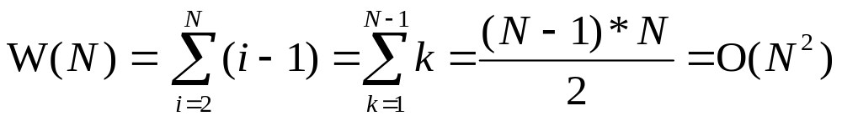
Worst-Case Analysis
(This happens when the original list is in decreasing order)
The outer loop is always done N – 1 times
The inner loop does the most work when the next element is smaller than all of the past elements
On each pass, the next element is compared to all earlier elements, giving:
Array index starts with 1
Array index starts with 0

Slide 10
Average-Case Analysis
There are (i + 1) places where the i ^{th} element can be added
(Note: This is true only if the array index starts with 0, instead of 1)
If it goes in the last location, we do one comparison
If it goes in the second last location, we do two comparisons
If it goes in the first or second location, we do i comparisons
Comparison: (list[location] > newElement)

Slide 11
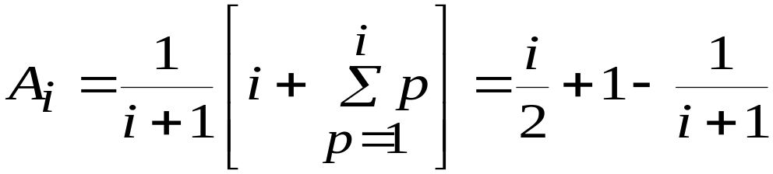
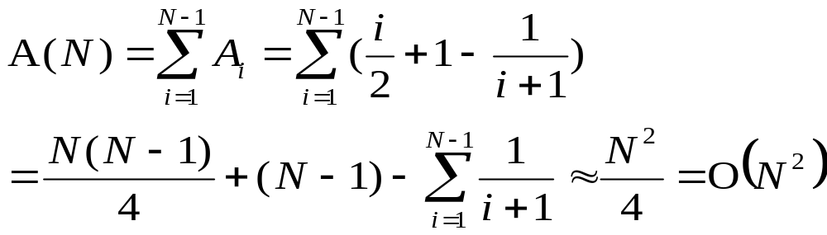
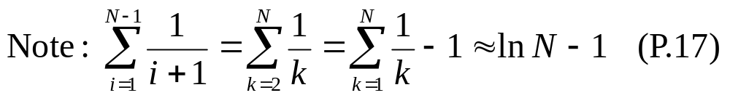
Average-Case Analysis
(Assuming the index i starts with 0)
The average number of comparisons to insert the i^{th} element is:
We now apply this for each of the algorithm’s passes:
(1 + 2 + … + i + i) / (i + 1)

Slide 12
Bubble Sort
If we compare pairs of adjacent elements and none are out of order, the list is sorted
If any are out of order, we must have to swap them to get an ordered list
Bubble sort will make passes though the list swapping any adjacent elements that are out of order

Slide 13
Bubble Sort
After the first pass, we know that the largest element must be in the correct place
After the second pass, we know that the second largest element must be in the correct place
Because of this, we can shorten each successive pass of the comparison loop

Slide 14
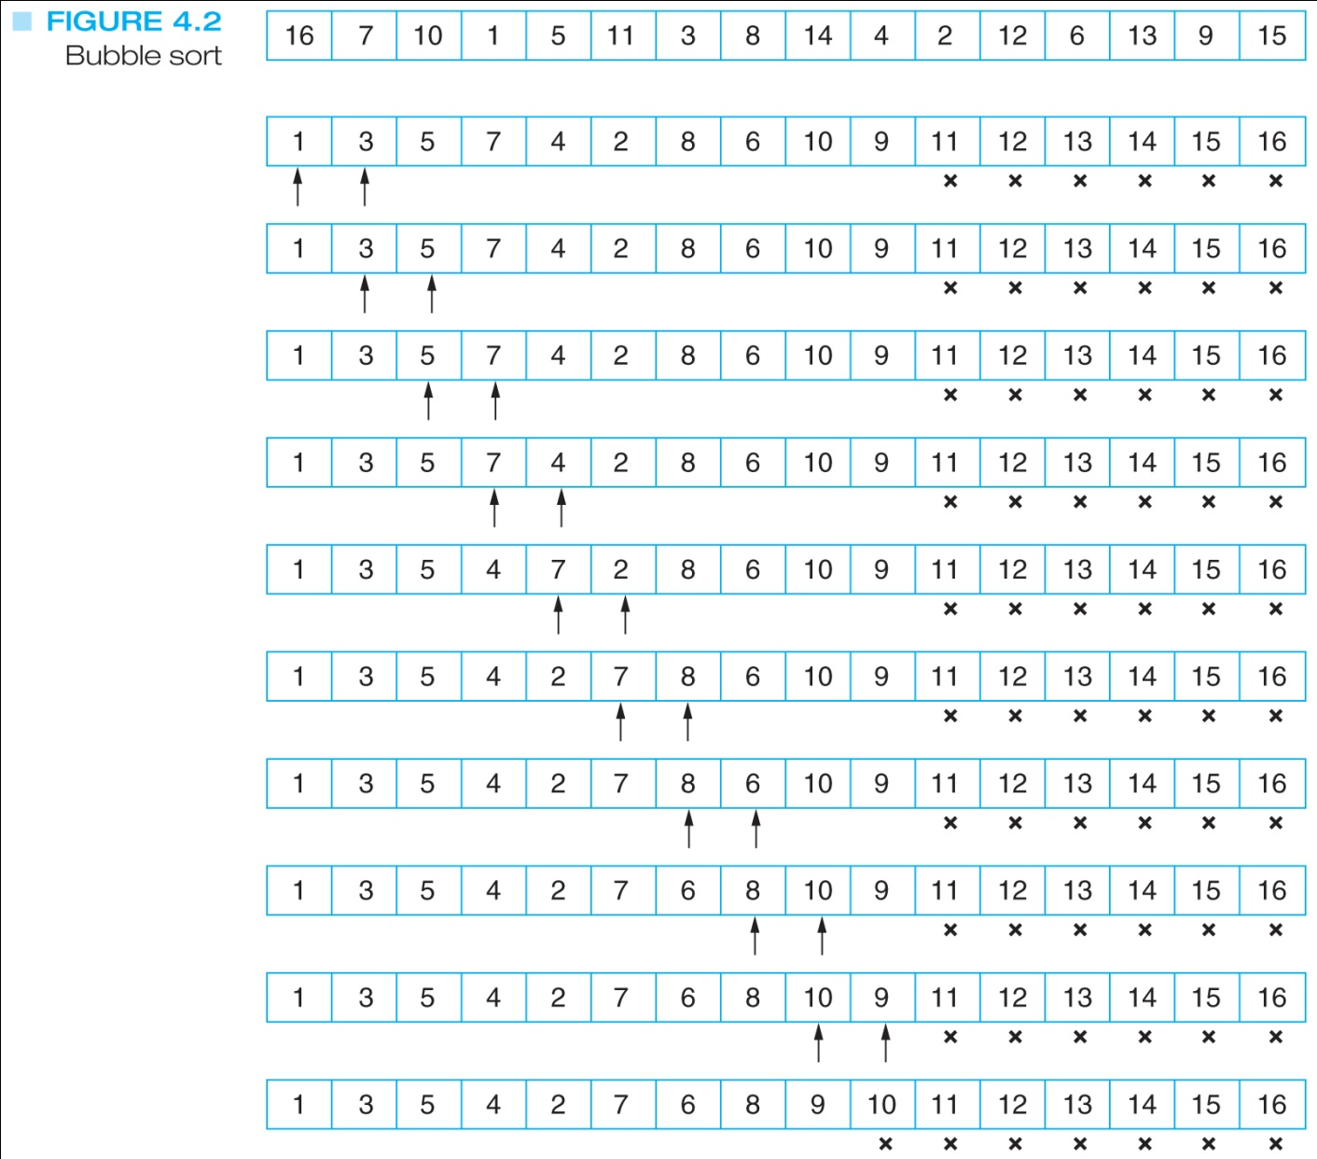
Bubble Sort Example
…

Slide 15
Bubble Sort Algorithm
numberOfPairs = N
swappedElements = true
while (swappedElements) do
  numberOfPairs = numberOfPairs - 1
  swappedElements = false
  for i = 1 to numberOfPairs do
    if (list[ i ] > list[ i + 1 ]) then
      Swap( list[i], list[i + 1] )
      swappedElements = true
    end if
  end for
end while

Slide 16
Best-Case Analysis
If the elements start in sorted order, the for loop will compare the adjacent pairs but not make any changes
So the swappedElements variable will still be false and the while loop is only done once
There are N – 1 comparisons in the best case

Slide 17
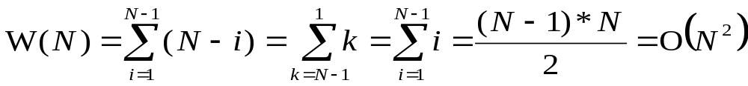
Worst-Case Analysis
In the worst case the while loop must be done as many times as possible. This happens when the data set is in the reverse order.
Each pass of the for loop must make at least one swap of the elements
The number of comparisons will be:

Slide 18
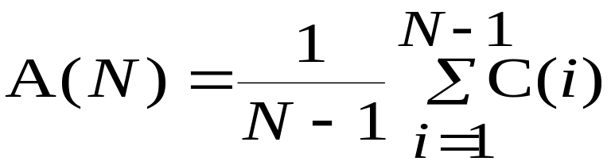
Average-Case Analysis
We can potentially stop after any of the (at most) N – 1 passes of the for loop
This means that we have N – 1 possibilities and the average case is given by
where C(i) is the work done in the first i passes (see next slide)

Slide 19
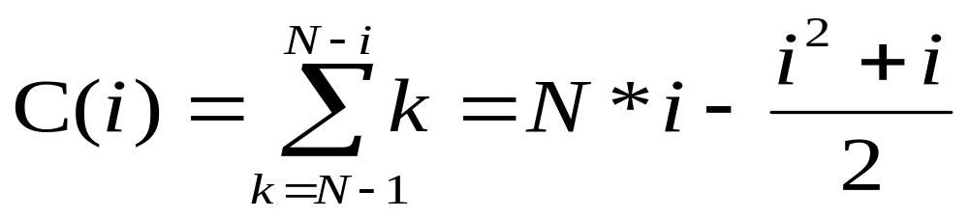
Average-Case Analysis
On the first pass, we do N – 1 comparisons
On the second pass, we do N – 2 comparisons
On the i-th pass, we do N – i comparisons
The number of comparisons in the first i passes, in other words C(i), is given by:

Slide 20
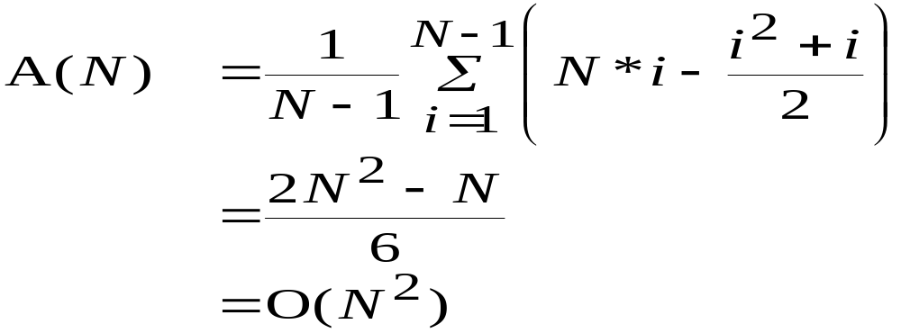
Average-Case Analysis
Putting the equation for C(i) into the equation for A(N) we get:

Slide 21
Shellsort
We can look at the list as a set of interleaved sublists
For example, the elements in the even locations could be one list and the elements in the odd locations the other list
Shellsort begins by sorting many small lists, and increases their size and decreases their number as it continues

Slide 22
Shellsort
One technique is to use decreasing powers of 2, so that if the list has 64 elements, the first pass would use 32 lists of 2 elements, the second pass would use 16 lists of 4 elements, and so on
These lists would be sorted with an insertion sort

Slide 23
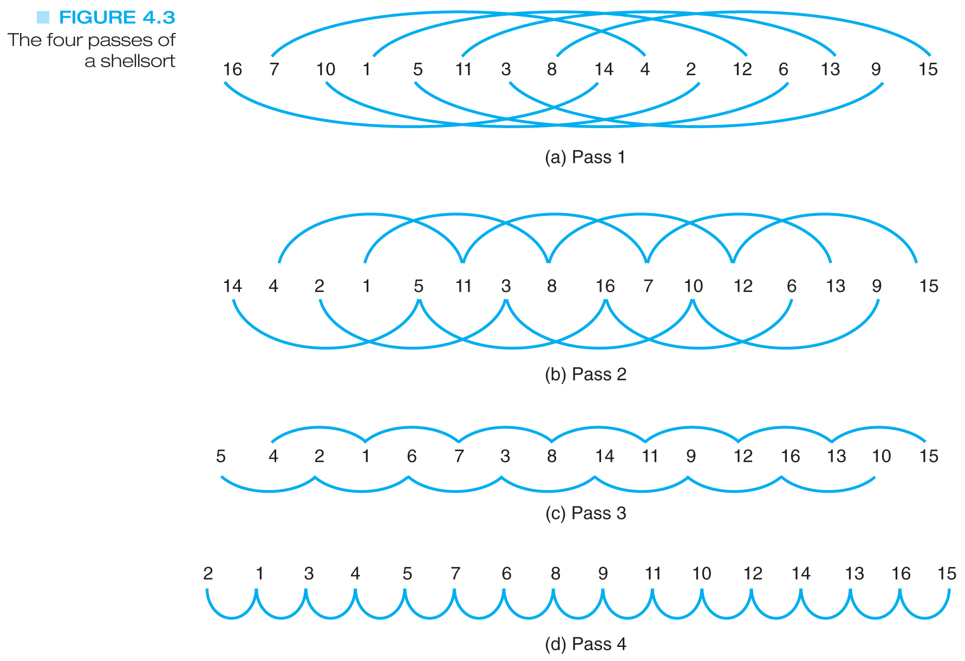
Shellsort Example
8 sublists
2 elements / sublist
Increment = 8
4 sublists
4 elements / sublist
Increment = 4
2 sublists
8 elements / sublist
Increment = 2
1 sublist
16 elements / sublist
Increment = 1

Slide 24
Shellsort Algorithm
passes = ⎣lg N⎦
while (passes ≥ 1) do
  increment = 2^{passes} - 1
  for start = 1 to increment do
    InsertionSort(list, N, start, increment)
  end for
  passes = passes - 1
end while
N=15 ➔
Pass 1: increment = 7, 7 calls, size = 2
Pass 2: increment = 3, 3 calls, size = 5
Pass 3: increment = 1, 1 call, size = 15

Slide 25

Shellsort Analysis
The set of increments used has a major impact on the efficiency of shellsort
With a set of increments that are one less than powers of 2, as in the algorithm given, the worst-case has been shown to be O(N^{3/2})
An order of O(N^{5/3}) can be achieved with just 2 passes with increments of and 1
Pass 1
Pass 2

Slide 26
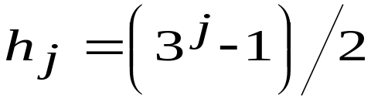
Shellsort Analysis
An order of O(N^{3/2}) can be achieved with a set of increments less than N that satisfy the equation:
… h(3) = 13, h(2) = 4, h(1) = 1
➔ h(j+1) = 3 h(j) + 1, with h(1) = 1
Using all possible values of 2^{i}3^{j} (in decreasing order) that are less than N will produce an order of
O(N(lg N)²)

Slide 27
Radix Sort
This sort is unusual because it does not directly compare any of the elements
We instead create a set of buckets and repeatedly separate the elements into the buckets
On each pass, we look at a different part of the elements

Slide 28
Radix Sort
Assuming decimal elements and 10 buckets, we would put the elements into the bucket associated with its units digit
The buckets are actually queues so the elements are added at the end of the bucket
At the end of the pass, the buckets are combined in increasing order

Slide 29
Radix Sort
On the second pass, we separate the elements based on the “tens” digit, and on the third pass we separate them based on the “hundreds” digit
Each pass must make sure to process the elements in order and to put the buckets back together in the correct order

Slide 30
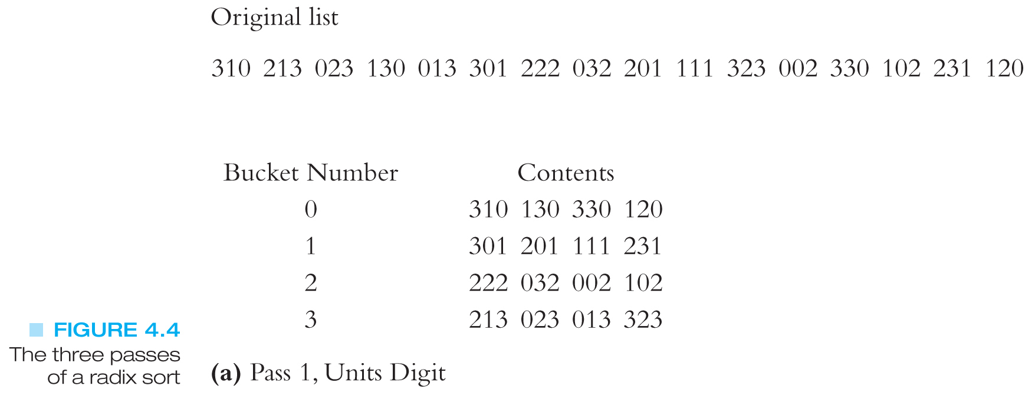
Radix Sort Example
⬅The unit digit is 0
⬅The unit digit is 1
⬅ The unit digit is 2
⬅ The unit digit is 3

Slide 31
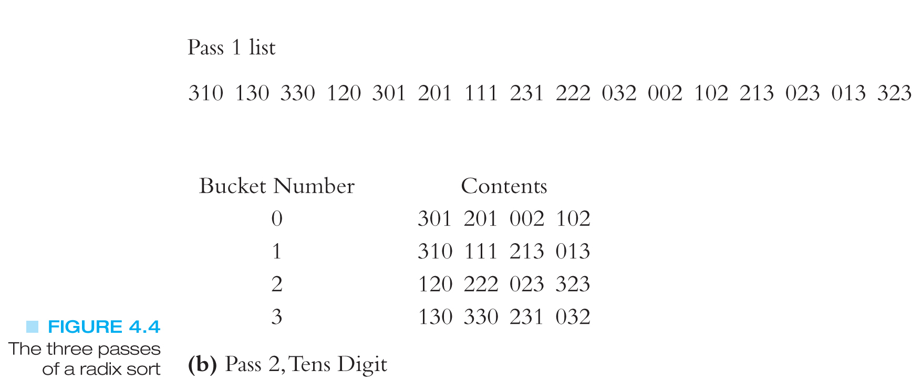
Radix Sort Example (continued)
The unit digits are already in order
Now start sorting the tens digit

Slide 32
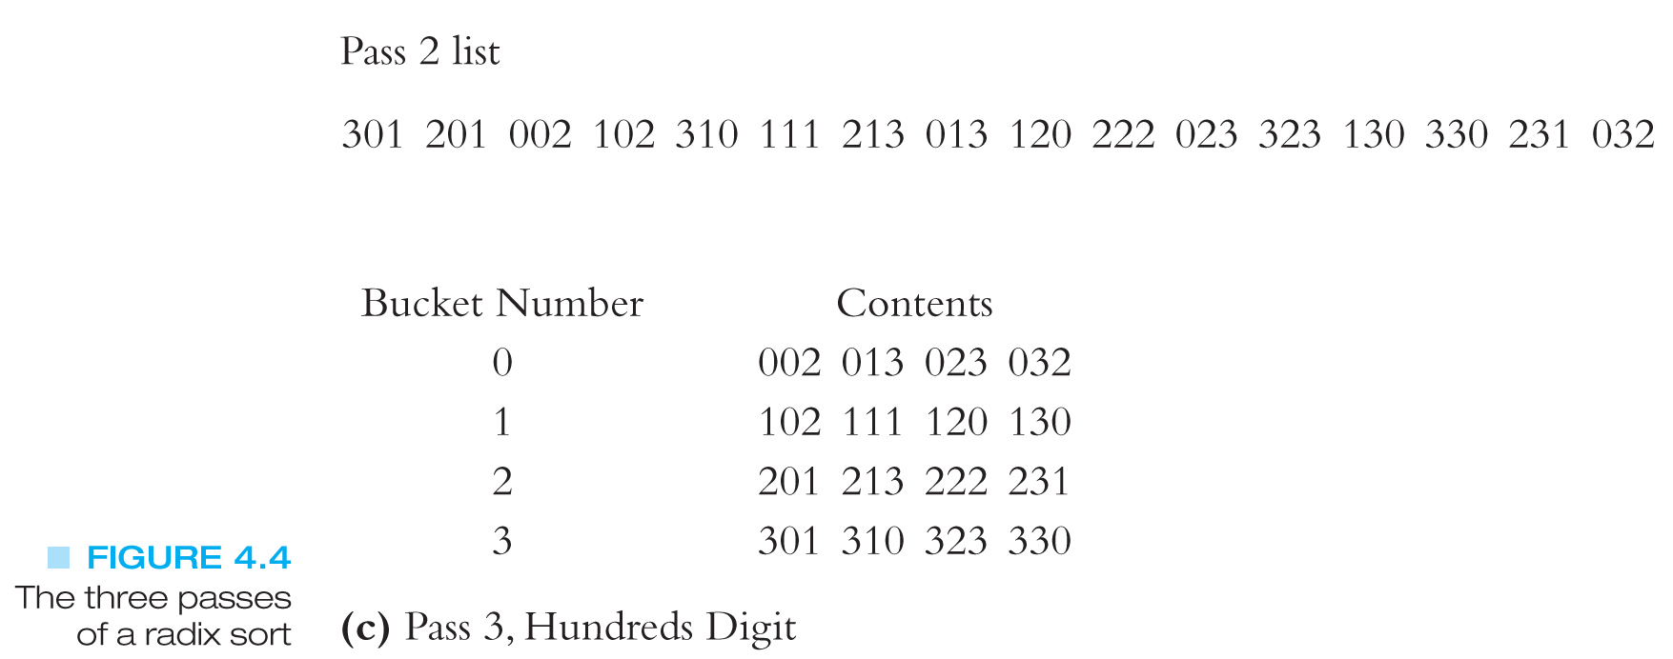
Radix Sort Example (continued)
The unit and tens digits are already in order
Values in the buckets are now in order
Now start sorting the hundreds digit

Slide 33
The Algorithm to sort a set of numeric keys
# of digits of the longest key
shift = 1
for pass = 1 to keySize do
  for entry = 1 to N do
    bucketNumber = (list[entry] / shift) mod 10
    Append( bucket[bucketNumber], list[entry] )
  end for
  list = CombineBuckets()
  shift = shift * 10
end for
# of elemnts in the list
quotient
remainder
bucketNumber: lies between 0 and 9

Slide 34
Radix Sort Analysis
Each element is examined once for each of the digits it contains, so if the elements have at most M digits and there are N elements this algorithm has order O(M*N)
This means that sorting is linear based on the number of elements
Why then isn’t this the only sorting algorithm used?

Slide 35
Radix Sort Analysis
Though this is a very time efficient algorithm it is not space efficient
If an array is used for the buckets and we have B buckets, we would need N*B extra memory locations because it’s possible for all of the elements to wind up in one bucket
If linked lists are used for the buckets you have the overhead of pointers

